Slide 1
Lecture 6 - Management Theory and Practice
Managing Business

Slide 2
Learning Outcomes
At the end of the lecture, you should be able to:
  Explain why studying management history is important.
  Discuss and contrast management theories from the era of scientific management to contingency theory.

Slide 3
Historical Background of Management
Ancient Management
  Egypt (pyramids) and China (Great Wall)
  Venetians (floating warship assembly lines)
Adam Smith
  Published “The Wealth of Nations” in 1776
    Advocated the division of labor (job specialisation) to increase the productivity of workers
Industrial Revolution
  Substituted machine power for human labor
  Created large organisations in need of management

Slide 4
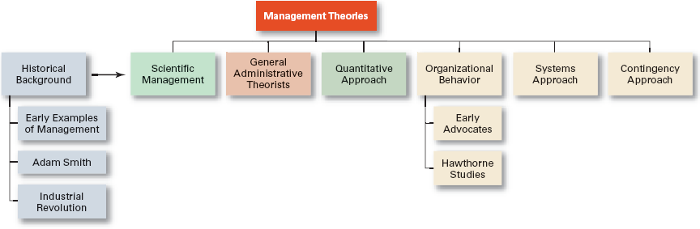
Development of Major Management Theories

Slide 5

Major Approaches to Management
Scientific Management
General Administrative Theory
Quantitative Management
Organisational Behavior
Systems Approach
Contingency Approach

Slide 6
Scientific Management
Fredrick Winslow Taylor
  The “father” of scientific management
  Published Principles of Scientific Management (1911)
    The theory of scientific management
      Using scientific methods to define the “one best way” for a job to be done:
        Putting the right person on the job with the correct tools and equipment.
        Having a standardised method of doing the job.
        Providing an economic incentive to the worker.

Slide 7
Taylor’s Four Principles of Management
Develop a science for each element of an individual’s work, which will replace the old rule-of-thumb method.
Scientifically select and then train, teach, and develop the worker.
Heartily cooperate with the workers so as to ensure that all work is done in accordance with the principles of the science that has been developed.
Divide work and responsibility almost equally between management and workers. Management takes over all work for which it is better fitted than the workers.

Slide 8
Scientific Management (cont’d)
Frank and Lillian Gilbreth
  Focused on increasing worker productivity through the reduction of wasted motion
  Developed the microchronometer to time worker motions and optimise work performance
How Do Today’s Managers Use Scientific Management?
  Use time and motion studies to increase productivity
  Hire the best qualified employees
  Design incentive systems based on output

Slide 9
General Administrative Theory
Henri Fayol
  Believed that the practice of management was distinct from other organisational functions
  Developed fourteen principles of management that applied to all organisational situations
Max Weber
  Developed a theory of authority based on an ideal type of organisation (bureaucracy)
    Emphasised rationality, predictability, impersonality, technical competence, and authoritarianism

Slide 10
Fayol’s 14 Principles of Management
Division of work.
Authority.
Discipline.
Unity of command.
Unity of direction.
Subordination of individual interests to the general interest.
Remuneration.
Centralisation.
Scalar chain.
Order.
Equity.
Stability of tenure of personnel.
Initiative.
Esprit de corps.

Slide 11
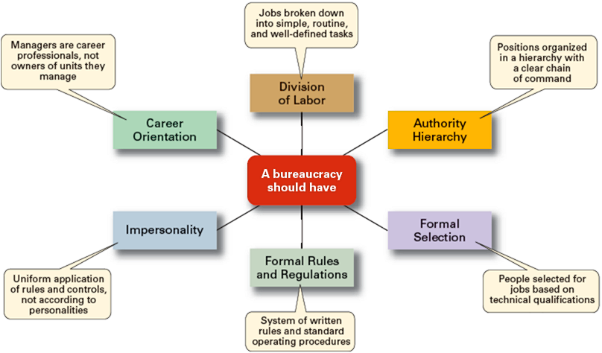
Weber’s Ideal Bureaucracy

Slide 12
Quantitative Approach to Management
Quantitative Approach
  Also called operations research or management science
  Evolved from mathematical and statistical methods developed to solve WWII military logistics and quality control problems
  Focuses on improving managerial decision making by applying:
    Statistics, optimisation models, information models, and computer simulations

Slide 13

Understanding Organisational Behavior
Organisational Behavior (OB)
  The study of the actions of people at work; people are the most important asset of an organisation
Early OB Advocates
  Robert Owen
  Hugo Munsterberg
  Mary Parker Follett
  Chester Barnard

Slide 14
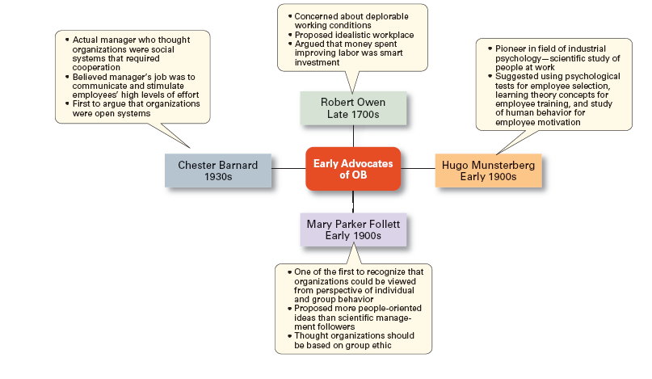
Early Advocates of OB

Slide 15
The Hawthorne Studies
A series of productivity experiments conducted at Western Electric from 1927 to 1932.
Experimental findings
  Productivity unexpectedly increased under imposed adverse working conditions.
  The effect of incentive plans was less than expected.
Research conclusion
  Social norms, group standards and attitudes more strongly influence individual output and work behavior than do monetary incentives.

Slide 16
The Systems Approach
System Defined
  A set of interrelated and interdependent parts arranged in a manner that produces a unified whole.
Basic Types of Systems
  Closed systems
    Are not influenced by and do not interact with their environment (all system input and output is internal).
  Open systems
    Dynamically interact to their environments by taking in inputs and transforming them into outputs that are distributed into their environments.

Slide 17
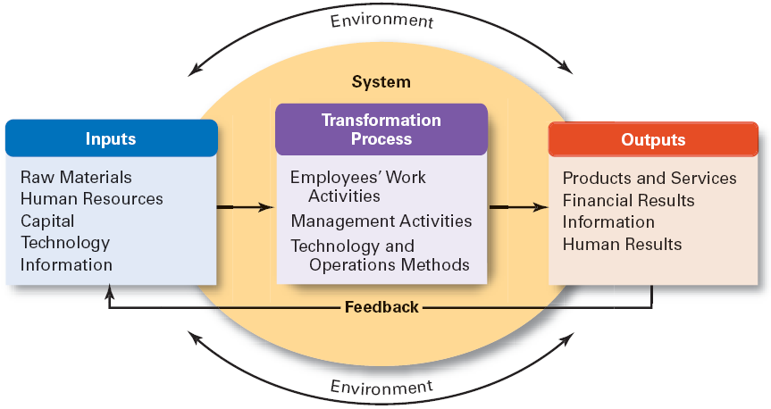
The Organisation as an Open System

Slide 18
Implications of the Systems Approach
Coordination of the organisation’s parts is essential for proper functioning of the entire organisation.
Decisions and actions taken in one area of the organisation will have an effect in other areas of the organisation.
Organisations are not self-contained and, therefore, must adapt to changes in their external environment.

Slide 19
The Contingency Approach
Contingency Approach Defined
  Also sometimes called the situational approach.
  There is no one universally applicable set of management principles (rules) by which to manage organisations.
  Organisations are individually different, face different situations (contingency variables), and require different ways of managing.

Slide 20
Popular Contingency Variables
Organisation size
  As size increases, so do the problems of coordination.
Routineness of task technology
  Routine technologies require organisational structures, leadership styles, and control systems that differ from those required by customised or non-routine technologies.
Environmental uncertainty
  What works best in a stable and predictable environment may be totally inappropriate in a rapidly changing and unpredictable environment.
Individual differences
  Individuals differ in terms of their desire for growth, autonomy, tolerance of ambiguity, and expectations.

Slide 21
Summary of Main Teaching Points
  Explain how today’s managers use general administrative theory.
  Discuss how today’s managers use the behavioral approach.
  Explain how the contingency approach differs from the early theories of management.
  Discuss how the contingency approach helps us understand management.

Slide 22
Question and Answer Session
Q & A

Slide 23
Next Session
Topic and Structure of next session
NEXT LESSON:
Planning and Decision Making

